Slide 1
8 Harmonics and Waves
How can regular, repeating motion be described with waves?

Slide 2
Contents
Simple Harmonic Motion and Springs
Simple Pendula
Energy in Harmonic Oscillators
Sine functions
Wave Motions

Slide 3
Harmonics
Many objects oscillate - an object on the end of a spring, a pendulum, a tuning fork, electrons in atoms and molecules, and the molecules themselves
When an object vibrates or oscillates back and forth, over the same path, each oscillation taking the same amount of time, the motion is periodic

Slide 4

Simple Harmonic Motion
An oscillating or vibrating object undergoes simple harmonic motion (SHM) if the restoring force is proportional to the (negative of) its displacement (Hooke’s Law)
Spring force = - (spring constant x displacement)
Hooke’s Law accurately describes springs, but other oscillating solids as well

Slide 5
Properties of Oscillations
Oscillations can be described by three properties:
Amplitude (A) - the maximum displacement from equilibrium
Period (T) - the time required to complete one full cycle
Frequency (f) - the number of cycles per second

Slide 6
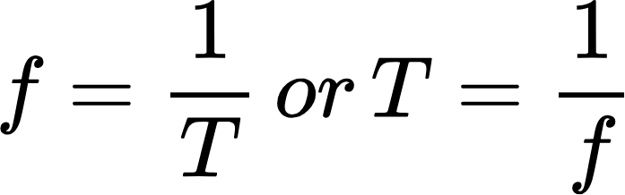
Frequency and Period
The unit of frequency is the Hz or s⁻¹ and represents the number of cycles that occur each second
Period (T) - the time required to complete one full cycle
Frequency (f) - the number of cycles per second

Slide 7
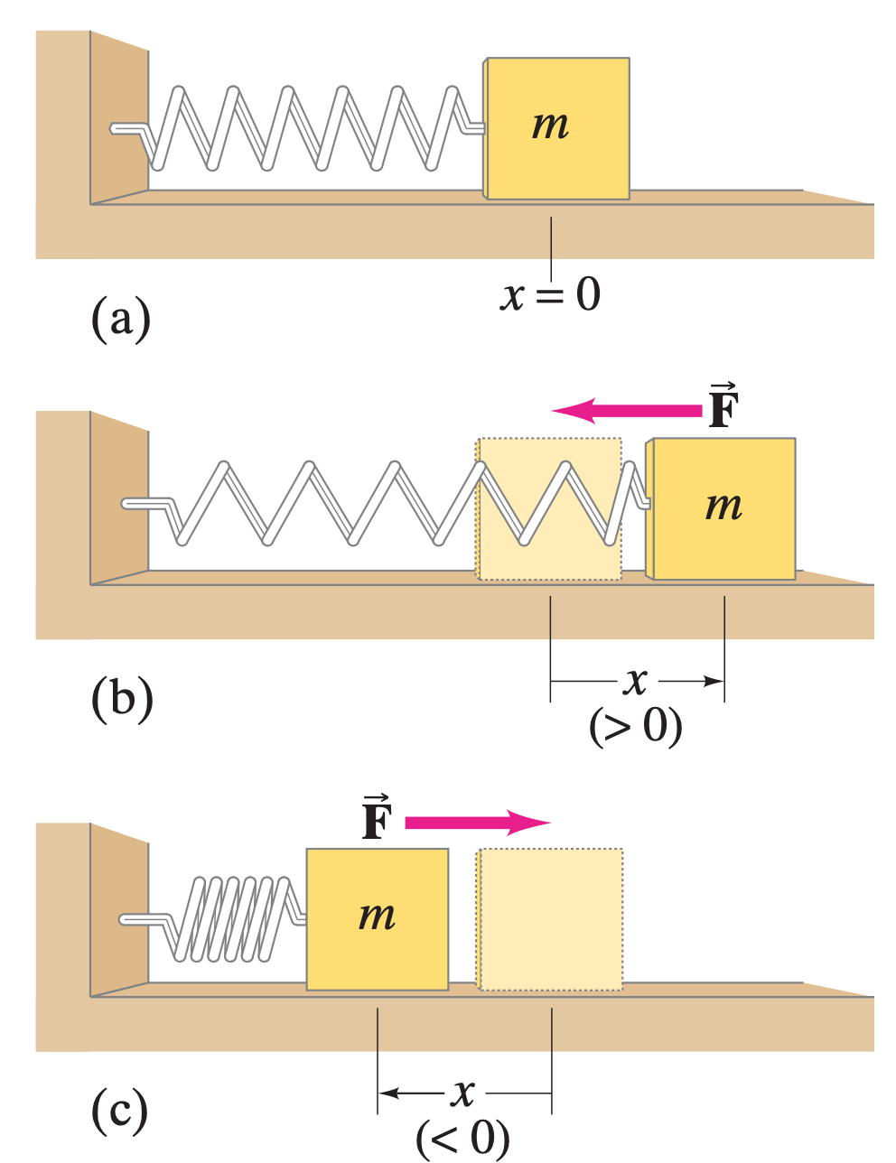
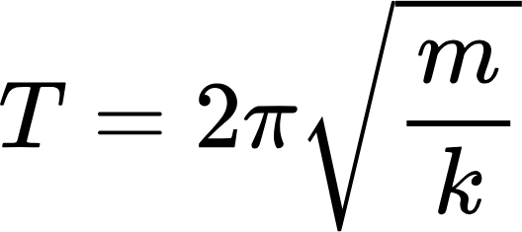
Frequency and Period
The period of oscillation for a mass m on the end of a spring with spring constant k is:
T is the period of time for the mass to complete one cycle of movement

Slide 8
Frequency and Period
Strange though it seems, the period is not dependent on amplitude
Displacing a spring farther increases its velocity, and therefore the period is kept constant

Slide 9
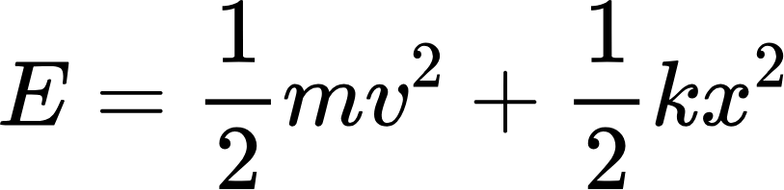
Transformation in SHM
During simple harmonic motion, the total energy of the system is conserved but its is continually changing from kinetic to potential (and back)

Slide 10
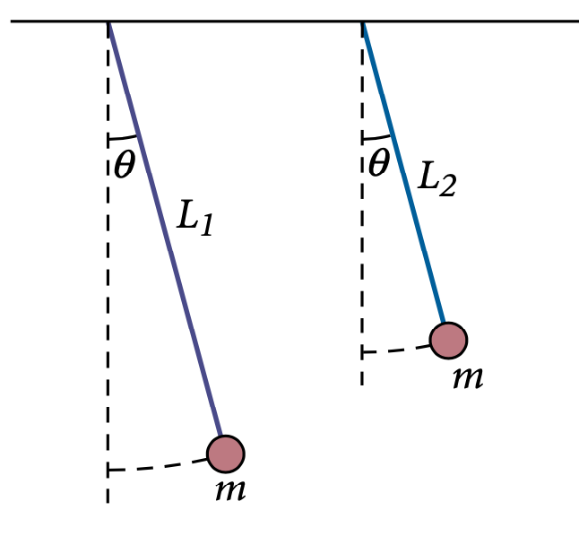
Simple Pendulum
When friction is present, the motion is damped
The maximum displacement of the pendulum decreases with time, mechanical energy is eventually transformed into thermal energy (friction)

Slide 11
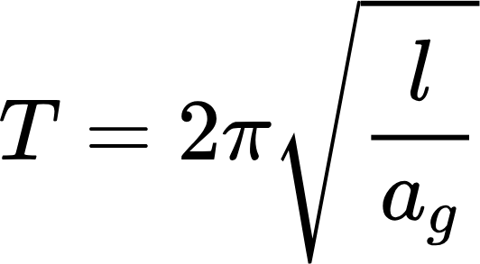
Simple Pendulum
A simple pendulum with length l approximates SHM if the amplitude is small and friction is negligible (when displacement angles are below 15°)
For small amplitudes, its period of a pendulum is given by:
This is the length of the pendulum
Note that the period depends only on length, not the mass or “bob”

Slide 12
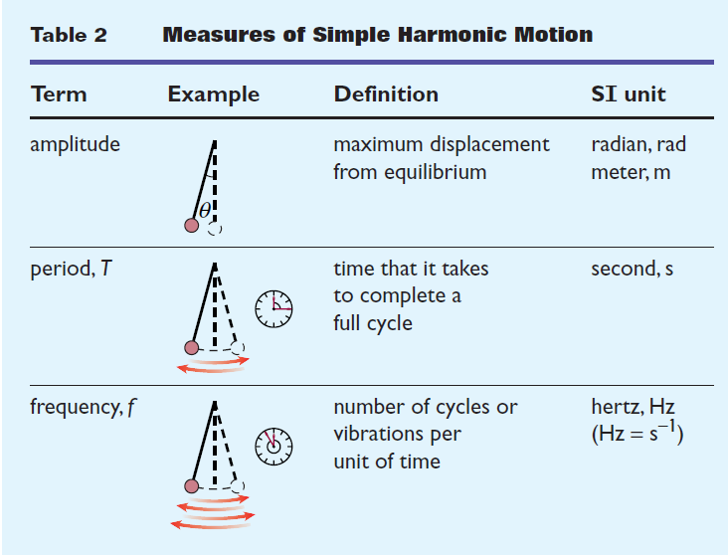
Measures of SHM

Slide 13

Wave Motions
A wave is the motion of a disturbance
Most waves require a medium, or material through which the disturbance travels
Waves that require a medium are called mechanical waves
Waves that do not require a medium are electromagnetic waves

Slide 14
Particles in Waves
Particles the medium oscillate, tracing a returning path but not traveling with the wave
As the wave passes, particles return to their original positions

Slide 15
Particles in Waves
Particles the medium oscillate, tracing a returning path but not traveling with the wave

Slide 16
Transverse and Longitudinal Waves
Transverse waves are waves where the particles move perpendicular to the wave
Example: dropping a pebble in a pond moves the water up and down, but the waves radiate outward laterally (to the sides)
Longitudinal waves are waves that travel parallel to the wave motion
Example: compressing and releasing a spring

Slide 17
Creating Waves
Vibrating objects act as sources of waves that travel outward from the source
Examples include waves in water or a string or cord

Slide 18
Wave Motions
The rate at which waves transfer energy depends on the amplitude at which the particles in the medium vibrate
For mechanical waves, the energy transferred is proportional to the square of the amplitude
When the amplitude of a wave is doubled, its energy increases by a factor of four

Slide 19
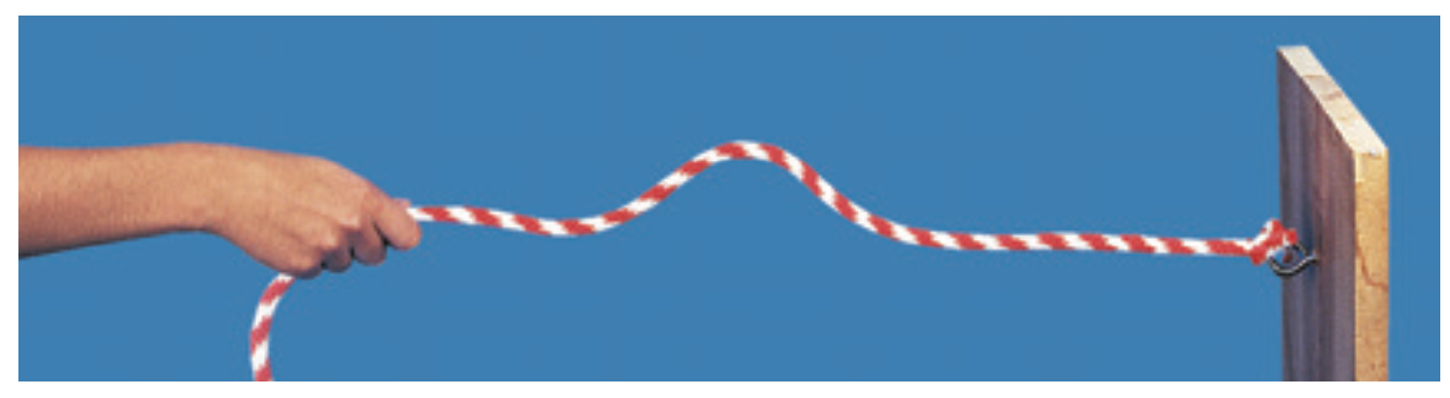
Creating Waves
A pulse is a single wave traveling through a medium

Slide 20
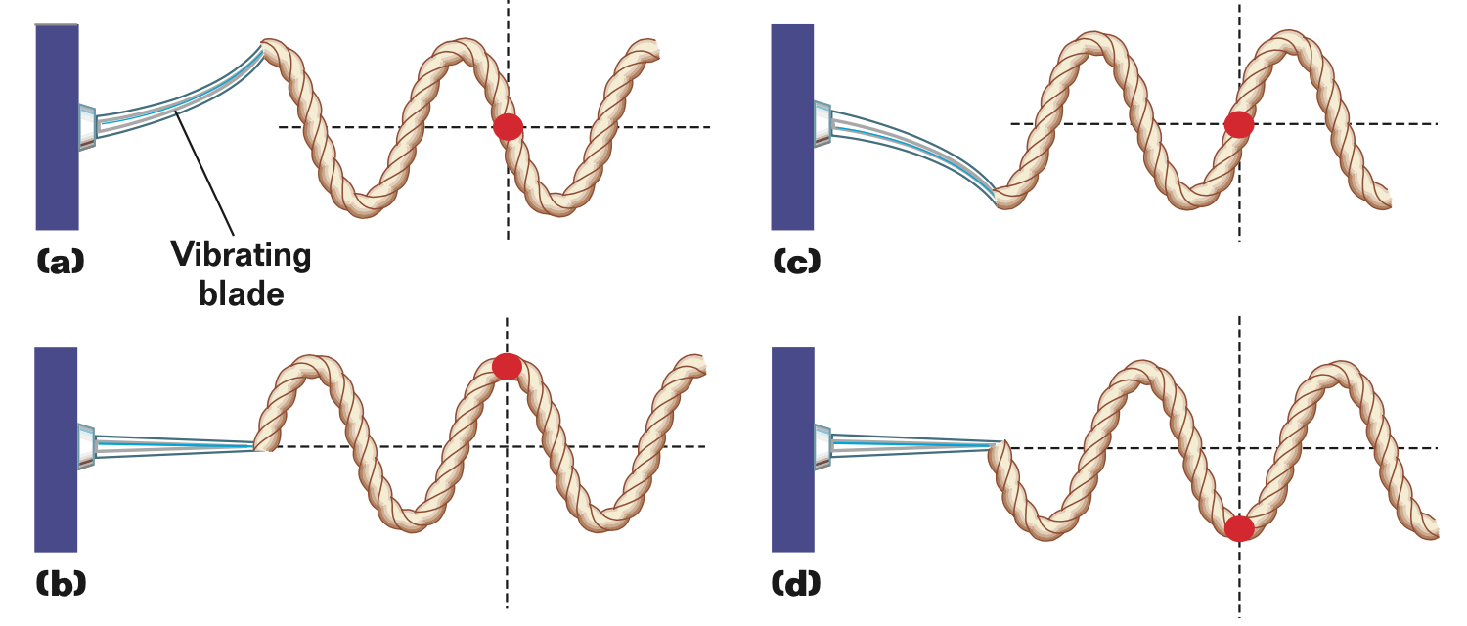
Creating Waves

Slide 21
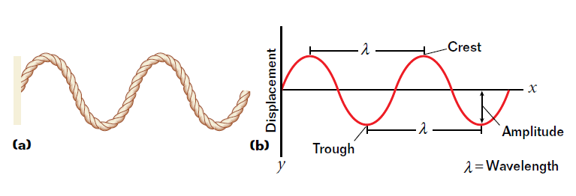
Creating Waves
Sine waves describe particles vibrating within harmonic motion
The trigonometric function y = sin x produces the curve when plotted
Wavelength (λ) - the distance a wave travels in one cycle or the distance between crests or troughs on a wave

Slide 22
Modeling Waves
Crest - the highest point above the equilibrium position
Trough - the lowest point below the equilibrium position

Slide 23
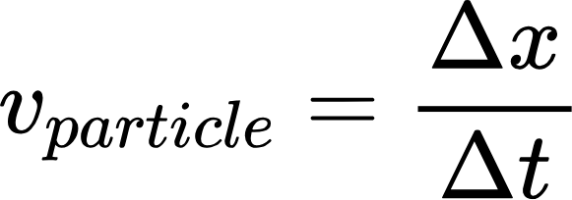
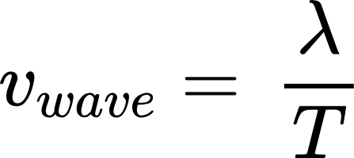
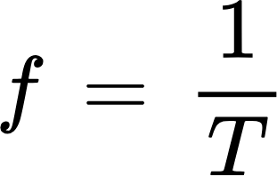
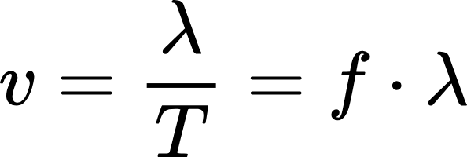
Moving Waves
A traveling wave can be represented mathematically
If
then
The velocity of a wave is its wavelength divided by its period
And since
then

Slide 24
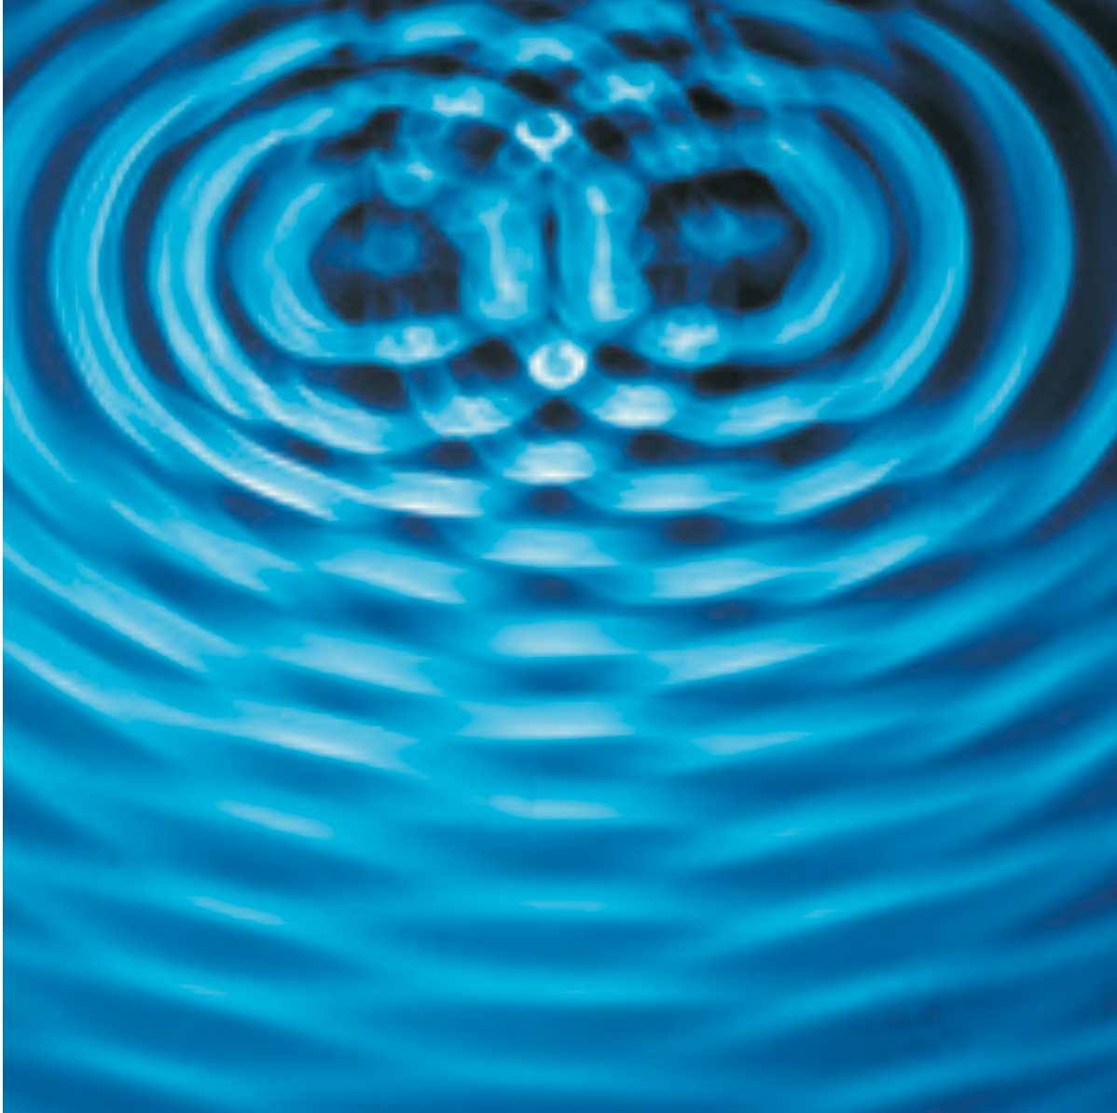
Interacting Waves
As waves move outward from their respective sources, they pass through one another
The waves interact to form an interference pattern

Slide 25
Colliding Waves
When waves come together, they do not collide as particles
Because mechanical waves are not matter, only its displacement, two waves can occupy the same space at the same time
Superposition is the combination of two overlapping waves at once

Slide 26
Colliding Waves
At each point in the wave, the displacements of the particles due to each wave are added
The resulting sum is the displacement of the resultant wave
Displacements in the same direction produce constructive interference
Displacements in opposite directions produce destructive interference

Slide 27
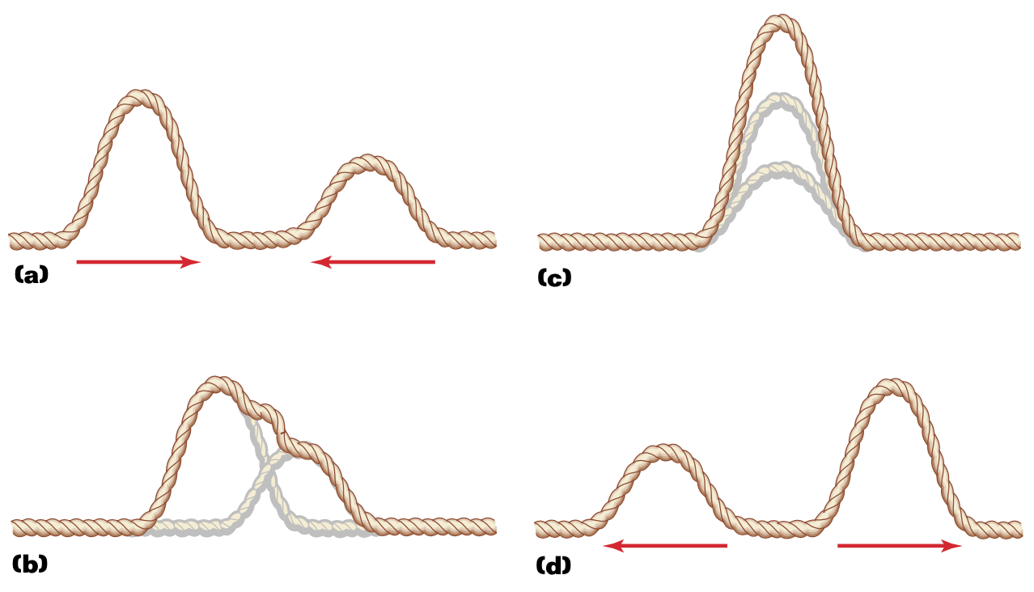
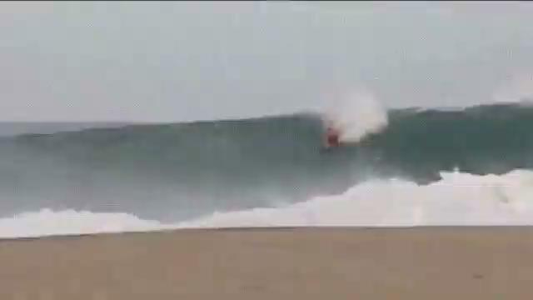
Colliding Waves
Displacements in the same direction produce constructive interference

Slide 28
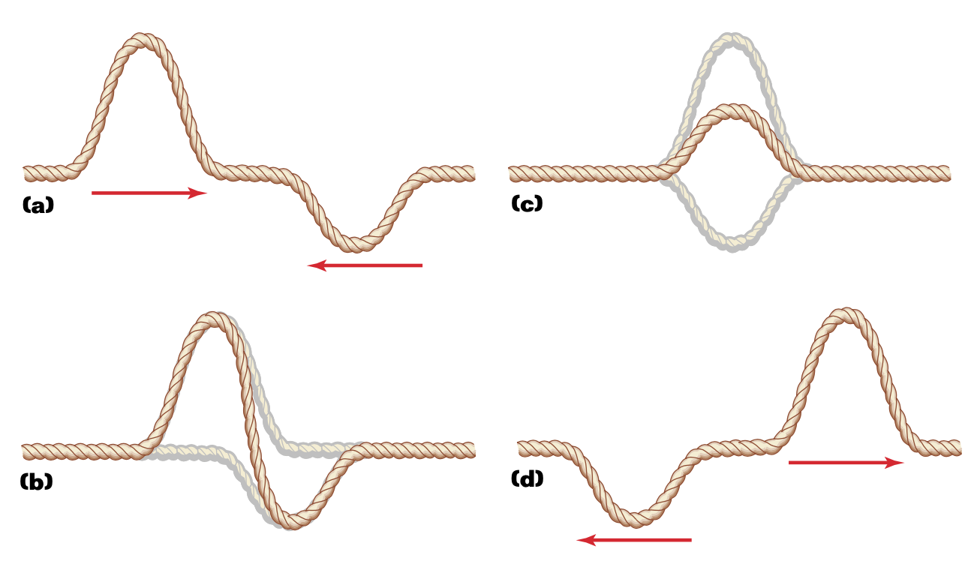
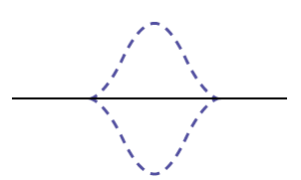
Colliding Waves
Displacements in opposite directions produce destructive interference
Resultant displacement at each point is zero; pulses cancel each other out

Slide 29
After collision
After the two pulses pass through each other, each pulse has the same shape it did before the waves met, and is still traveling in the same direction
This is true for sound waves, water waves, light waves, and many others
Waves maintain their own characteristics after interference

Slide 30
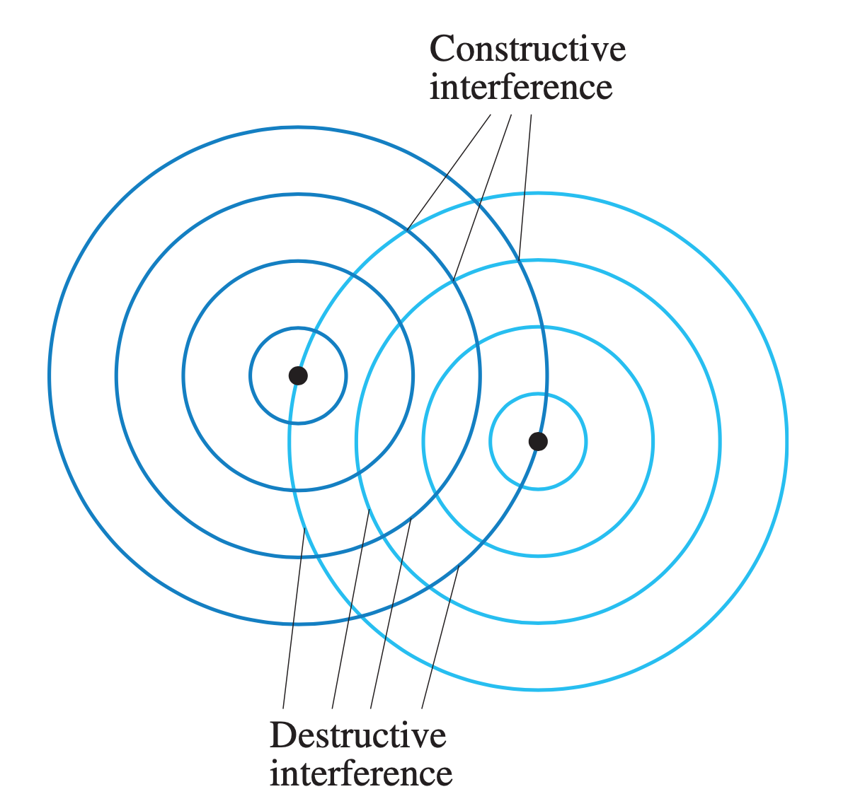
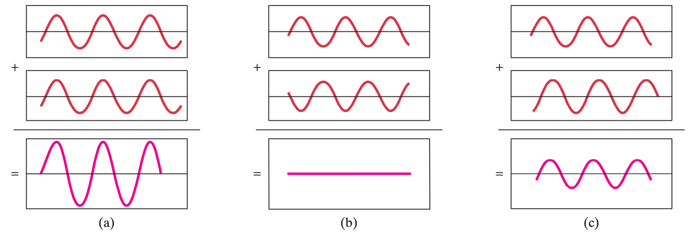
After collision
Constructive
Destructive
Partial

Slide 31
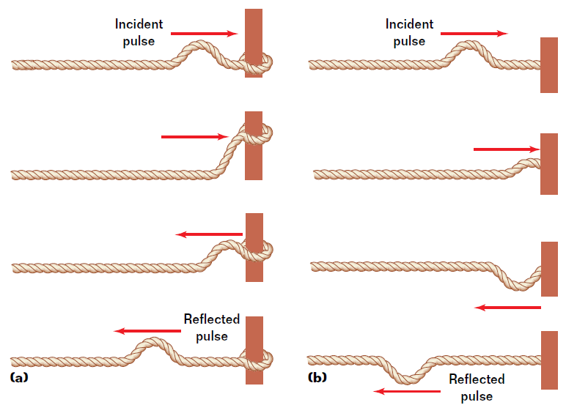
Reflection
When a pulse reaches a boundary, two changes can occur:
If it is a free boundary, the wave reflects, changing direction and maintaining its amplitude and orientation

Slide 32
Reflection
When a pulse reaches a boundary, two changes can occur:
If it is a fixed boundary, the wave reflects, changing direction and is also inverted

Slide 33
Standing Waves
If a medium is vibrated at exactly the right frequency, a standing wave can be formed
A standing wave is a wave that appears to stand motionless due to alternating regions of constructive and destructive interference
Nodes are points of complete destructive interference (displacement = 0)
Antinodes are points of largest amplitude, caused by perfectly aligned constructive interference

Slide 34
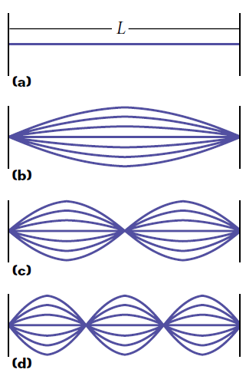
Standing Waves
Nodes are points of complete destructive interference (displacement = 0)
Antinodes are points of largest amplitude, caused by perfectly aligned constructive interference
Only certain frequencies (and therefore wavelengths) produce standing waves

Slide 35
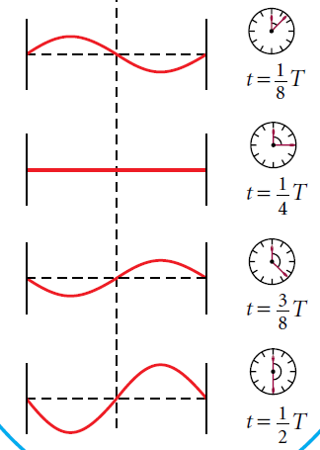
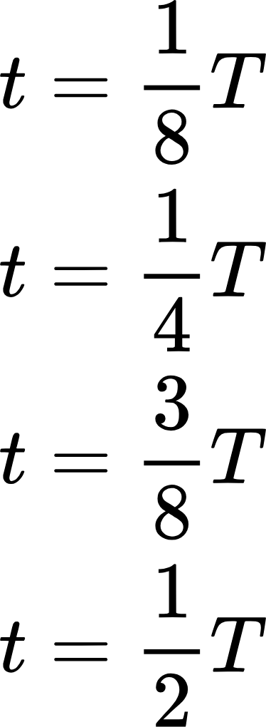
Standing Waves
Only certain frequencies (and therefore wavelengths) produce standing waves
For any given wave of period T, four standing waves can exist:

Slide 36
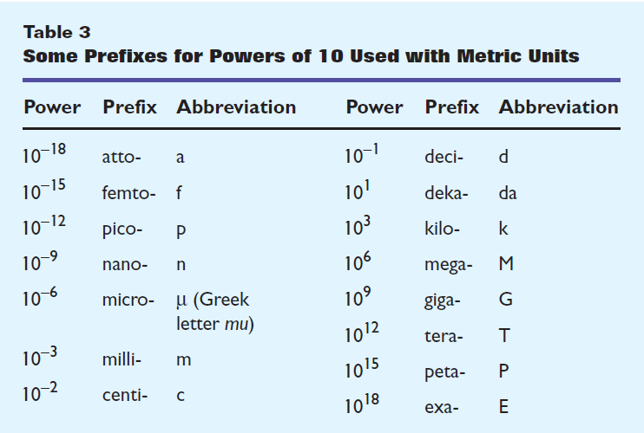
The Scales of Things

Slide 37
Example 1 | A pendulum clock
A pendulum clock is being designed to have a period of exactly 1.0 s. How long should the pendulum be?
Notes:
Holt, Sample B, Q2
25 cm

Slide 38
Example 2 | Suspension on a car
The body of a 1 275 kg car is supported on a frame by four springs. Two people riding in the car have a combined mass of 153 kg. When driven over a pothole in the road, the frame vibrates with a period of 0.840 s. For the first few seconds, the vibration approximates SHM. Find the spring constant of the suspension springs.
Notes:
Holt, Sample C, pp. 380
2.00 x 10⁴ N/m each

Slide 39
Example 3 | A piano string
A piano string tuned to middle C vibrates with a frequency of 262 Hz. Assuming the speed of sound in air is 343 m/s, find the wavelength of the sound waves produced by the string.
Notes:
Holt, Sample D, p. 387
Wavelength = 1.31 m

